Slide 1
Mini Test Preparation
Year 11 Mathematics Essentials Unit 2 Mini-Test 1.1

Slide 2
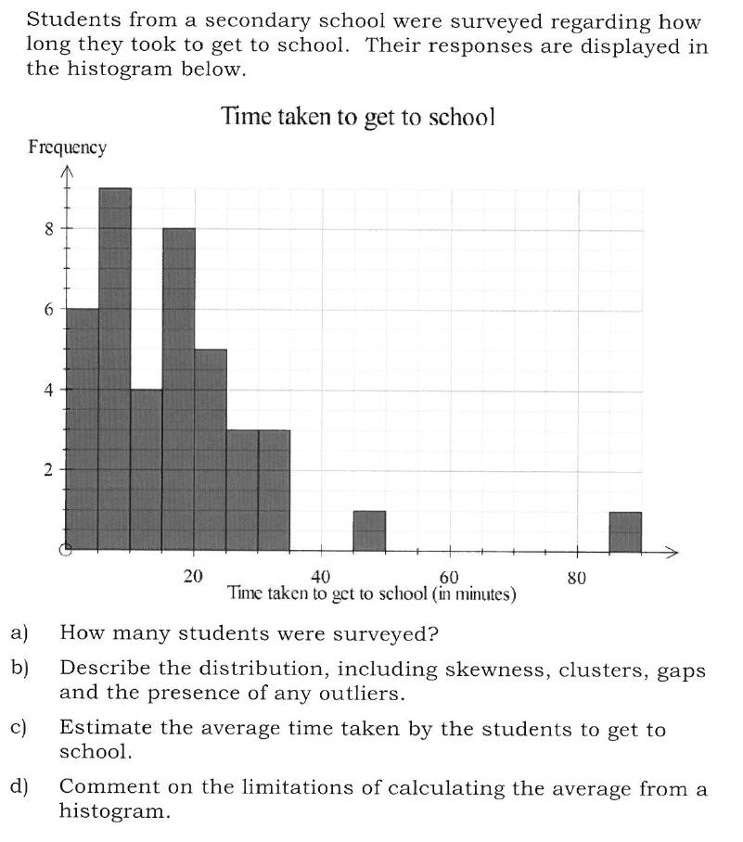
HistoGrams - Interpreting - Skewness

Slide 3
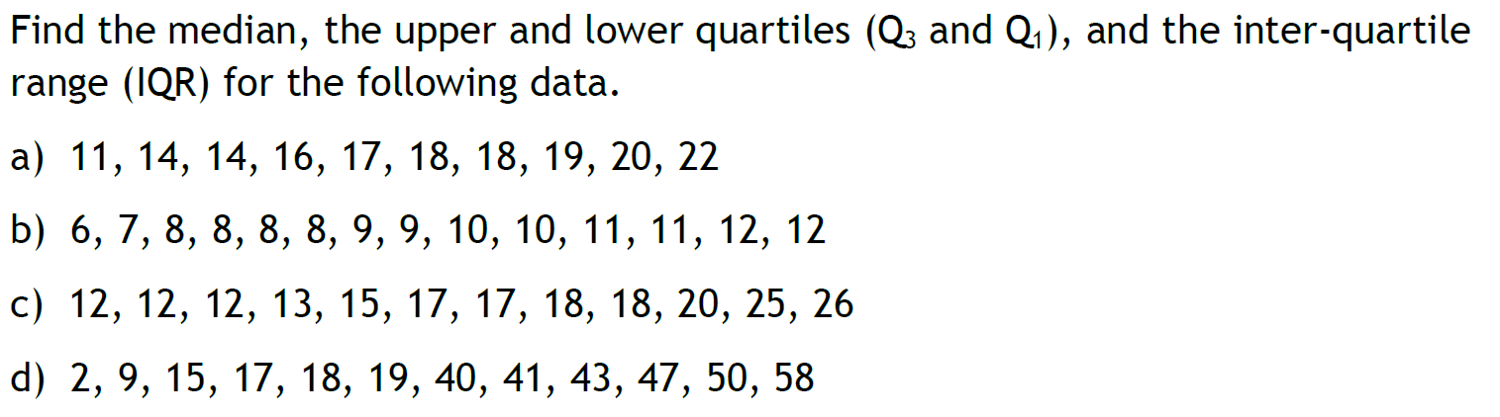
Five Number Summary - Minimum - Lower quartile - Median - Upper quartile - Maximum
Don’t forget about the interquartile range!

Slide 4
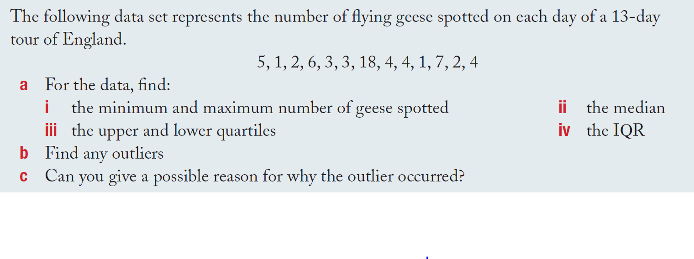
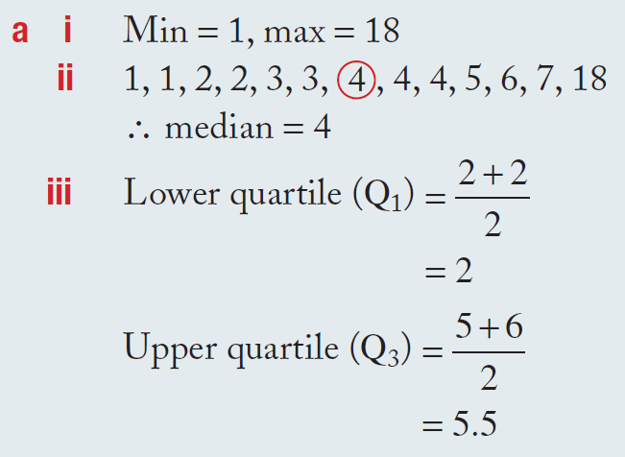
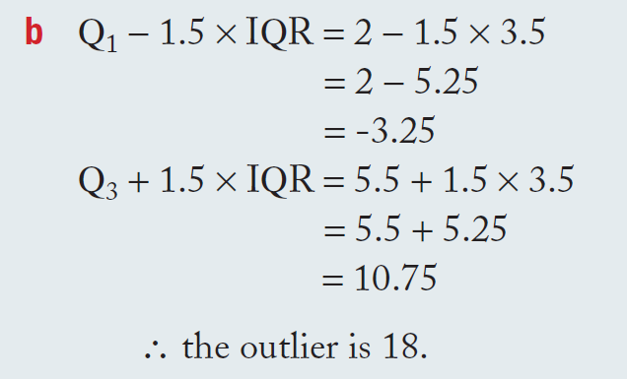
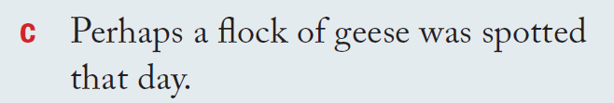
Outliers

Slide 5
24
7
30
Topic: Five Number Summary
Date: 26/07/2018
EQ – How do we interpret a box and whisker plot?
How do we tell whether a value is an outlier?
Steps

Slide 6
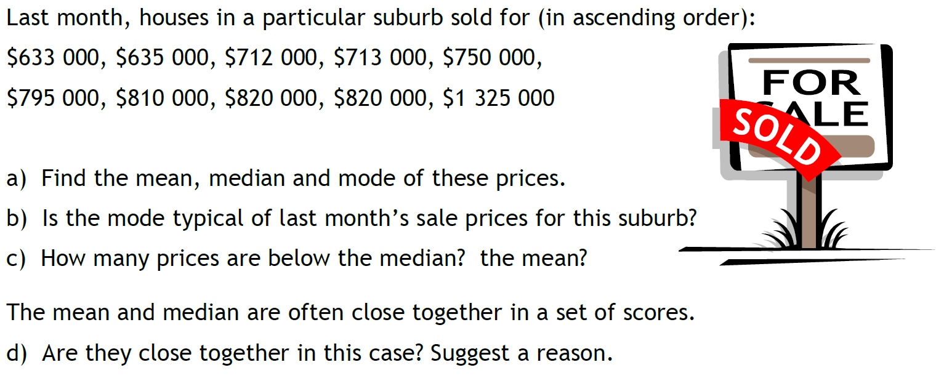
Measures of Centre - Mean, Median, Mode

